Slide 1
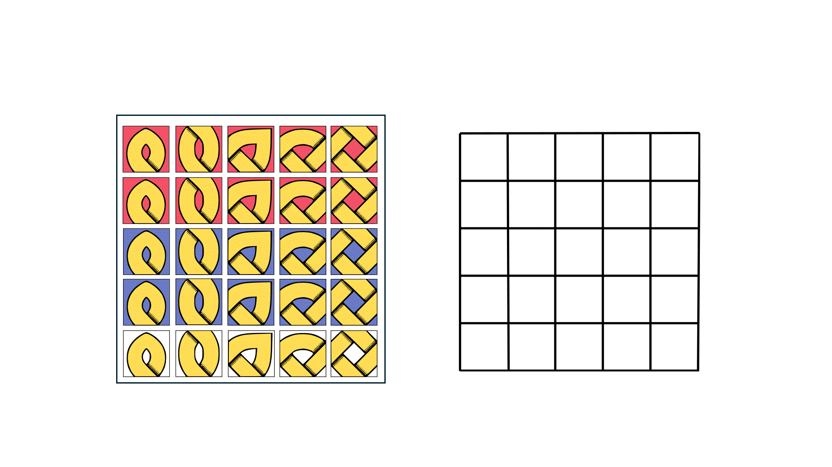
Tile-based Knot Assembly with Celtic!
Authors: Divya Bajaj, Ryan Knobel, Juan Manuel Perez, Rene Reyes, Ramiro Santos, Tim Wylie

Slide 2
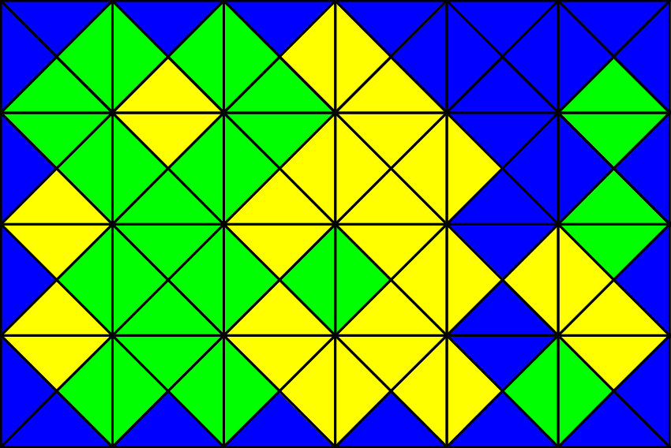
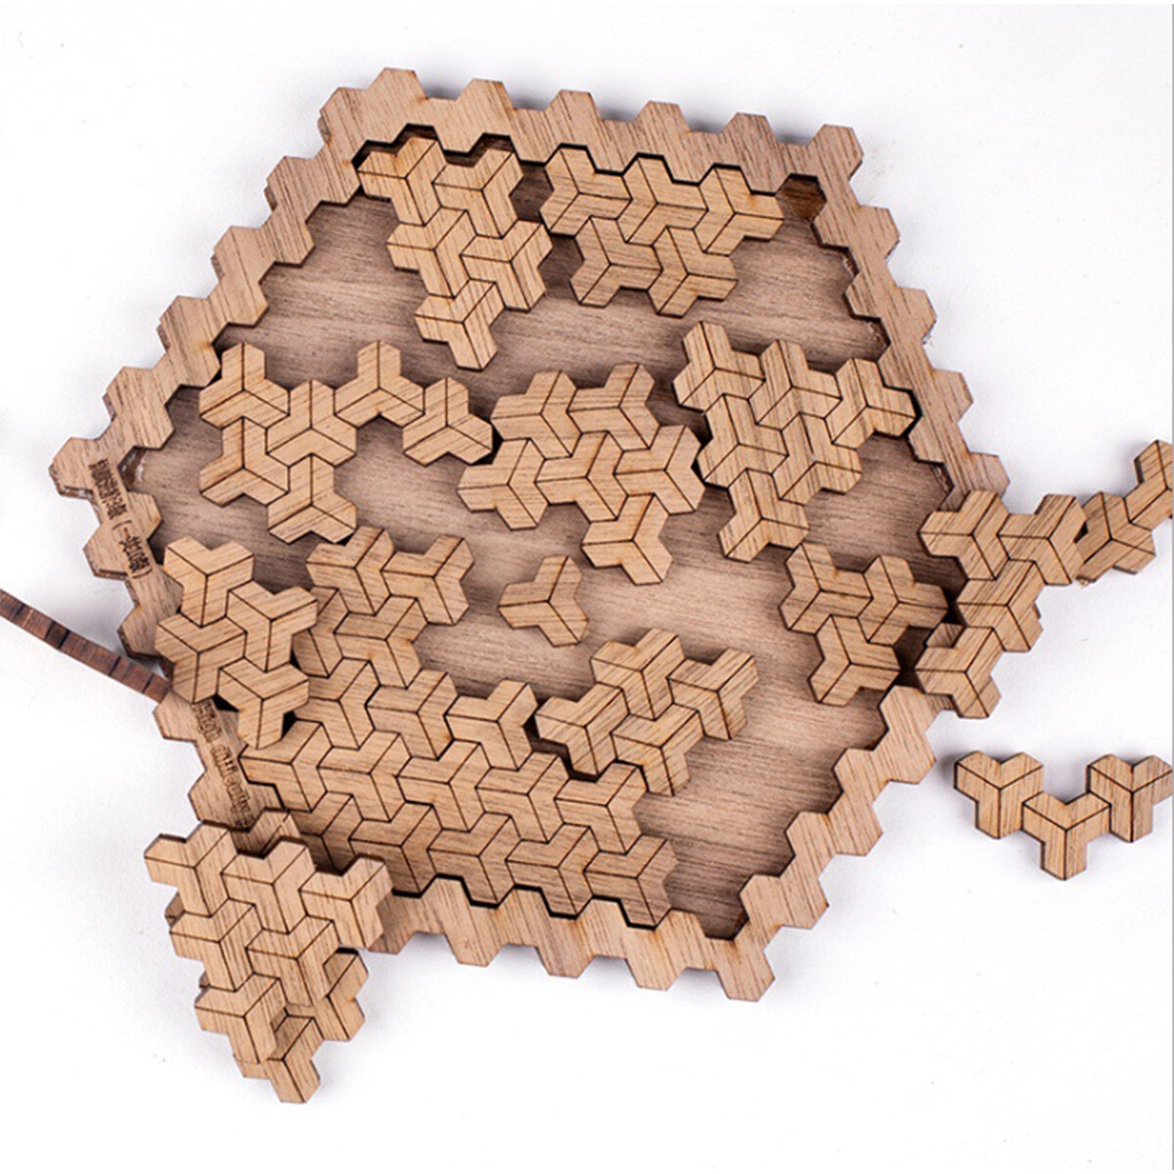
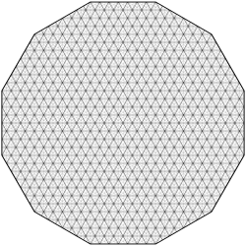
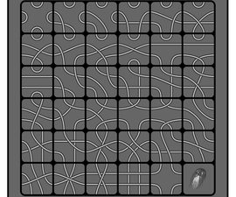
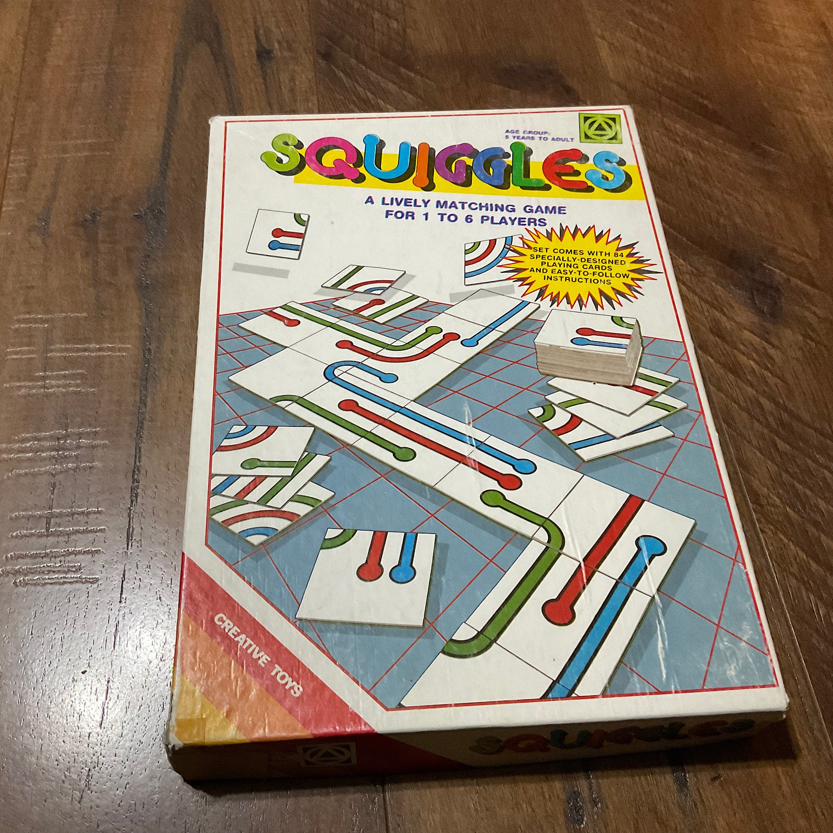
Background
MacMahon Squares
Jigsaw Puzzles
Eternity
Tsuro
Squiggles

Slide 3
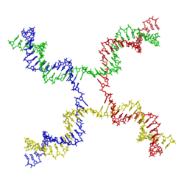
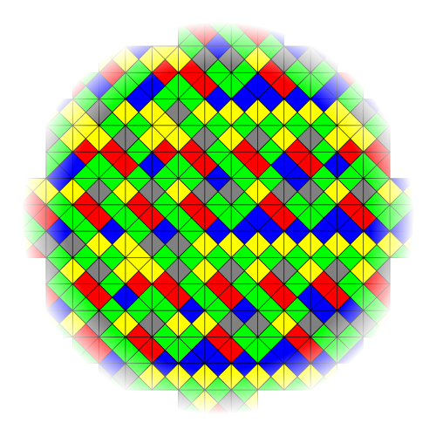

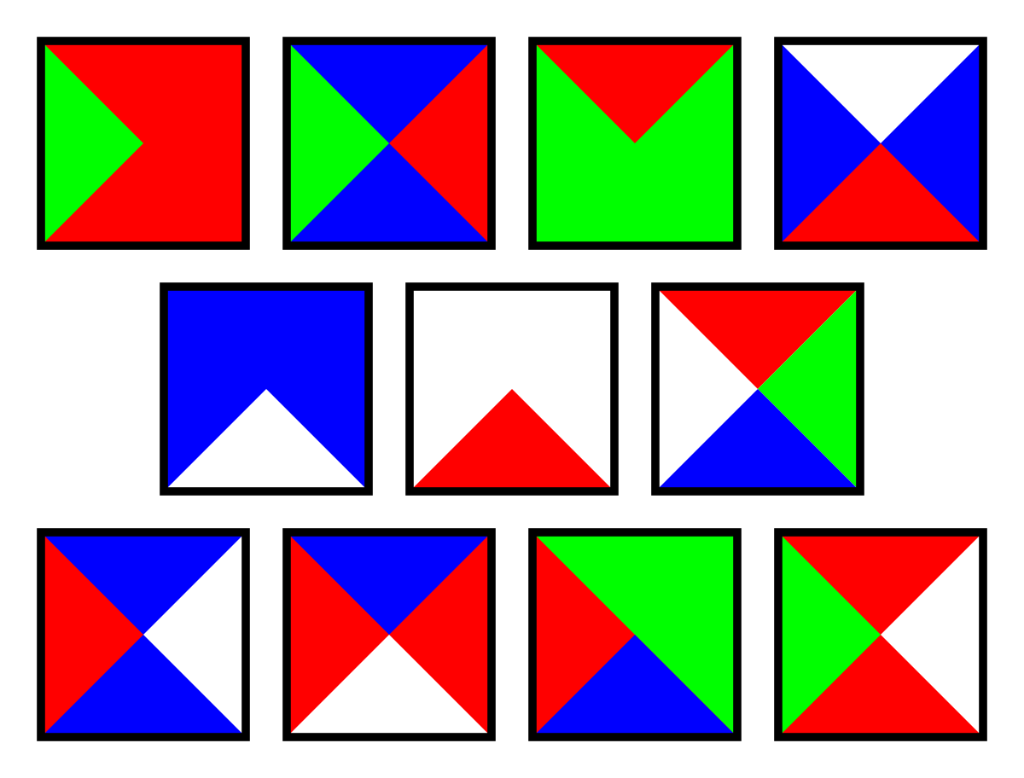
Background
[Knot Theory Wikipedia]
Wang tiles

Slide 4





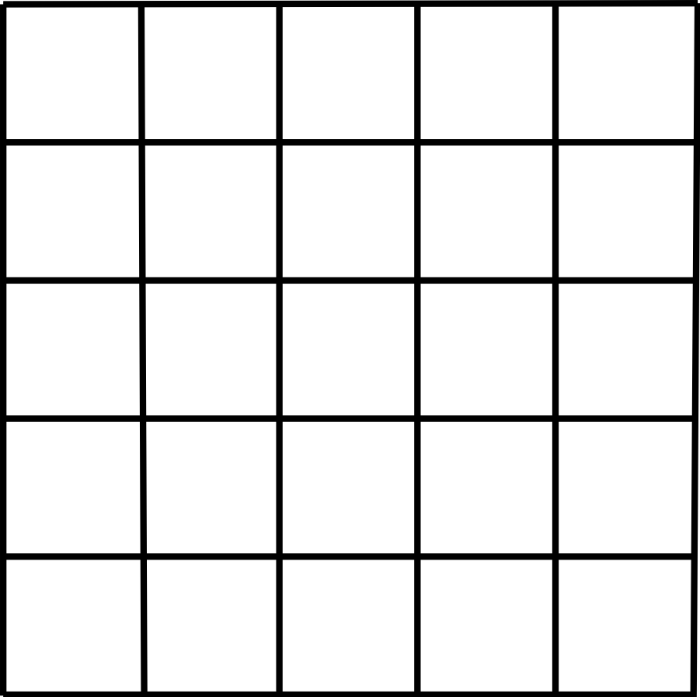










Celtic!
Board
Pieces

Slide 5
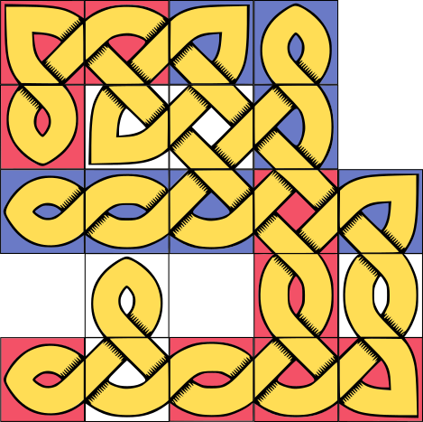
Celtic! - Scoring

Slide 6

Celtic! - Scoring
1
1

Slide 7
Celtic! - Scoring
1
1
Score
Knot 1: Tie

Slide 8
Celtic! - Scoring
Score
Knot 1: Tie

Slide 9
















Celtic! - Scoring
1
1
Score
Knot 1: Tie
2
3
2,3
4
8,9
4
5
6
7

Slide 10













Celtic! - Scoring
1
1
Score
Knot 1: Tie
Knot 2: Red (9)
2
3
2,3
4
8,9
4
5
6
7

Slide 11
Celtic! - Scoring
Score
Knot 1: Tie
Knot 2: Red (9)

Slide 12
Celtic! - Scoring
Score
Knot 1: Tie
Knot 2: Red (9)
Knot 3: Blue (5)
Knot 4: Red (4)

Slide 13
Celtic! - Scoring
Score
Knot 1: Tie
Knot 2: Red (9)
Knot 3: Blue (5)
Knot 4: Red (4)

Slide 14
Generalized 2-Player Celtic!

Slide 15

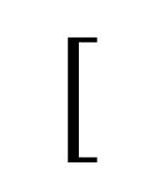



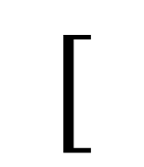



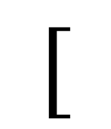
Generalization: 2-Player
$$[$$
$$]$$
$$[$$
$$]$$
$$⋮$$
$$n$$
Player Pieces
$$[$$
$$]$$
$$⋯$$
Board Pieces
$$n$$
Problem: Does the blue player have a winning strategy?

Slide 16
2-Player Celtic!
Player Pieces | Board Pieces | Complexity
 |  | PSPACE-complete
Problem: Does the blue player have a winning strategy?

Slide 17
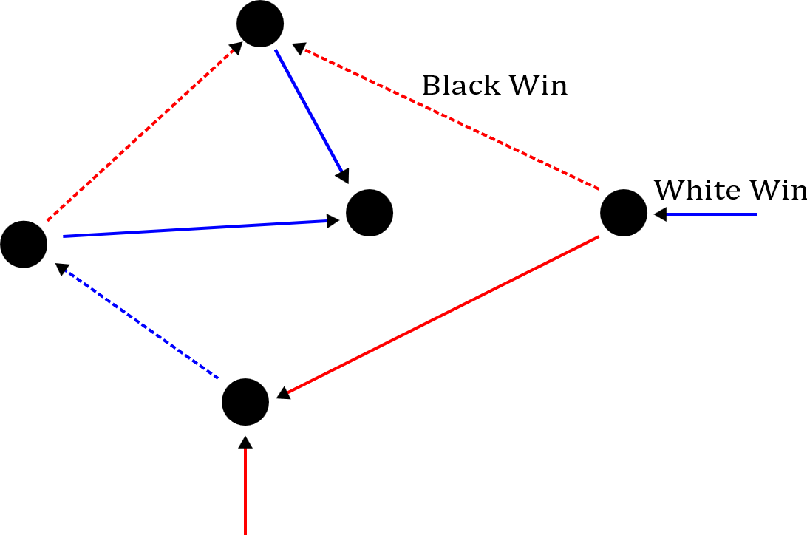
2-Player Celtic!
Bounded 2-Player Constraint Logic
Given directed graph with edges of weights 1 or 2
Edges are partitioned for Black (dotted)/White (solid) players
Goal is to flip a specific edge

Slide 18

2-Player Celtic!
Bounded 2-Player Constraint Logic
Given directed graph with edges of weights 1 or 2
Edges are partitioned for Black (dotted)/White (solid) players
Goal is to flip a specific edge

Slide 19
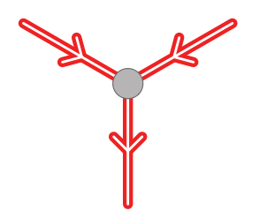
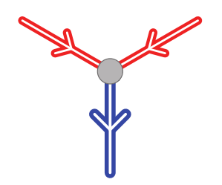

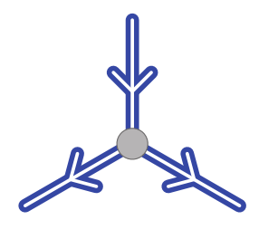
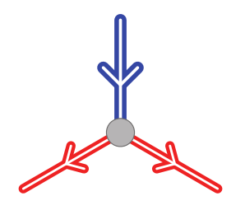
2-Player Celtic!
Choice
Fanout
OR
Variable
AND

Slide 20
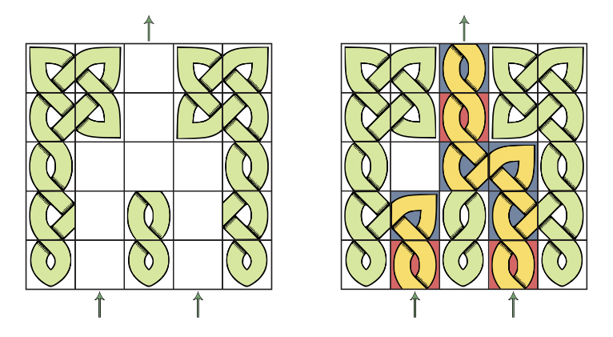
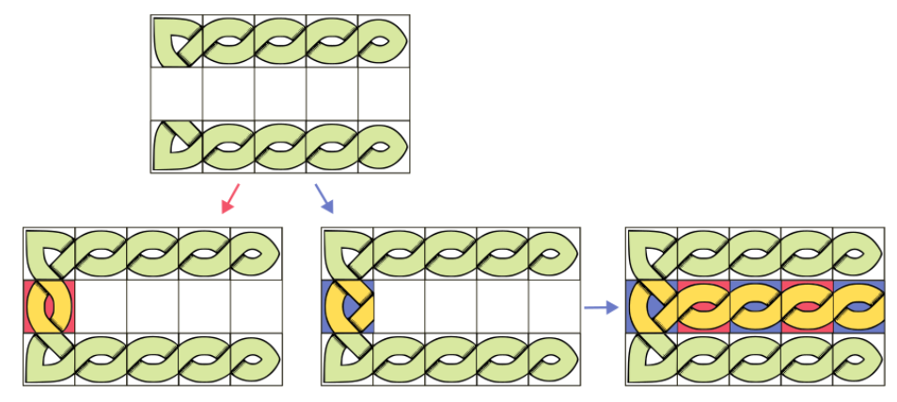
2-Player Celtic!
Variable
OR

Slide 21
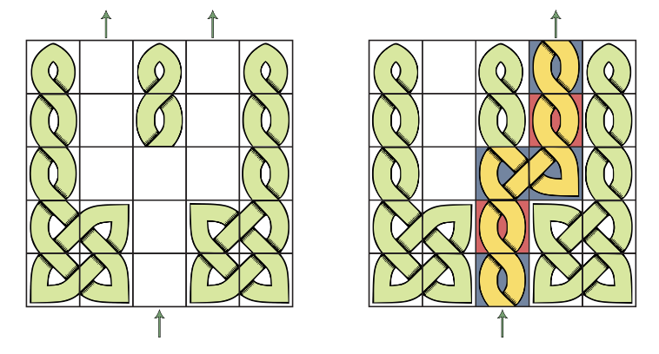
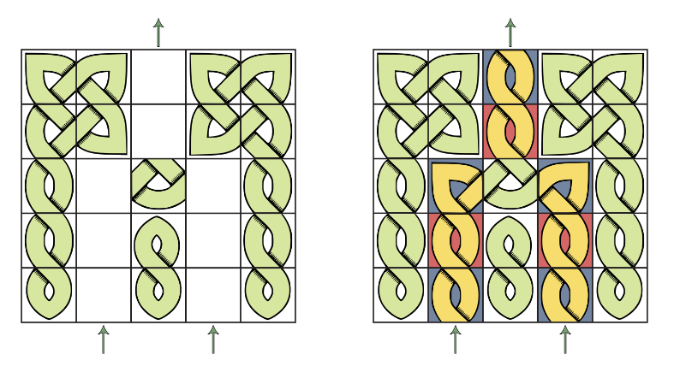
2-Player Celtic!
Choice
AND

Slide 22
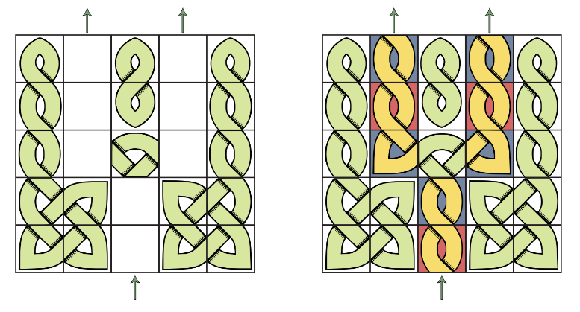
2-Player Celtic!
Fanout

Slide 23
Generalized 1-Player Celtic!

Slide 24

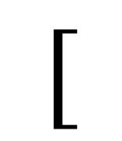

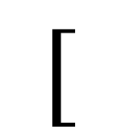
Generalization: 1-Player
$$[$$
$$]$$
Player Pieces
$$⋮$$
$$n$$
$$[$$
$$]$$
Board Pieces
$$⋯$$
$$n$$
Problem: Can the player build a knot of size $≥L$ given $k$ pieces?

Slide 25
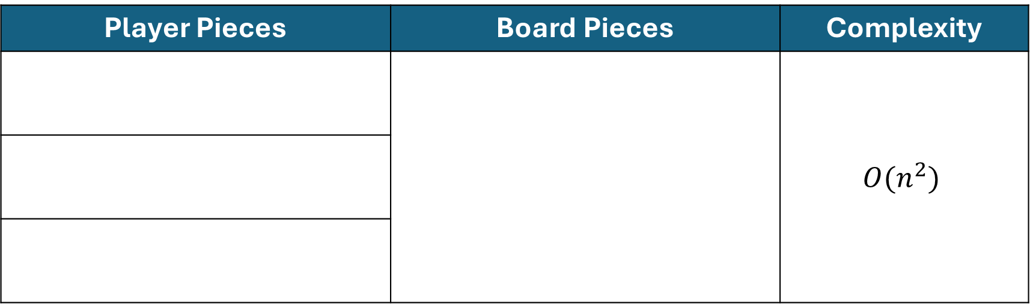
1-Player Celtic!: The “Easy” problems
Player Pieces | Board Pieces | Complexity
 |  | $$O(n^{2})$$
Problem: Can the player build a knot of size $≥L$ given $k$ pieces?

Slide 26
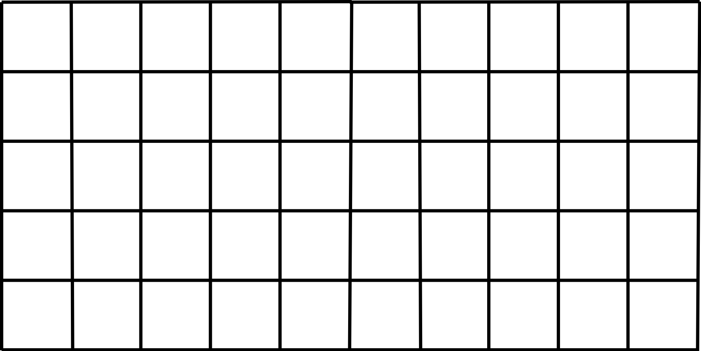
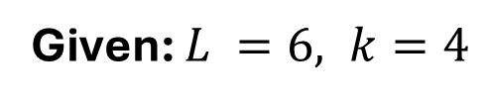
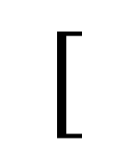

1-Player Celtic!: The “Easy” problems
$$[$$
$$]$$
Player Pieces
Given: $L =6, k=4$

Slide 27
1-Player Celtic!: The “Easy” problems
$$[$$
$$]$$
Player Pieces
Given: $L =6, k=4$

Slide 28
1-Player Celtic!: The “Easy” problems
$$[$$
$$]$$
Player Pieces
Given: $L =6, k=4$

Slide 29
1-Player Celtic!: The “Easy” problems
$$[$$
$$]$$
Player Pieces
Given: $L =6, k=4$

Slide 30
1-Player Celtic!: The “Easy” problems
$$[$$
$$]$$
Player Pieces
Given: $L =6, k=4$

Slide 31
1-Player Celtic!: The “Easy” problems
$$[$$
$$]$$
Player Pieces
Given: $L =6, k=4$

Slide 32
1-Player Celtic!: The “Easy” problems
$$[$$
$$]$$
Player Pieces
Given: $L =6, k=4$

Slide 33
1-Player Celtic!: The “Easy” problems
$$[$$
$$]$$
Player Pieces
Given: $L =6, k=4$

Slide 34
1-Player Celtic!: The “Hard” problems
Player Pieces | Board Pieces | Complexity
 |  | NP-complete
Problem: Can the player build a knot of size $≥L$ given $k$ pieces?

Slide 35
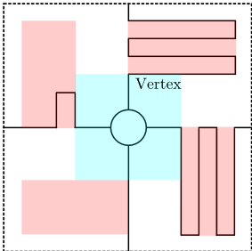
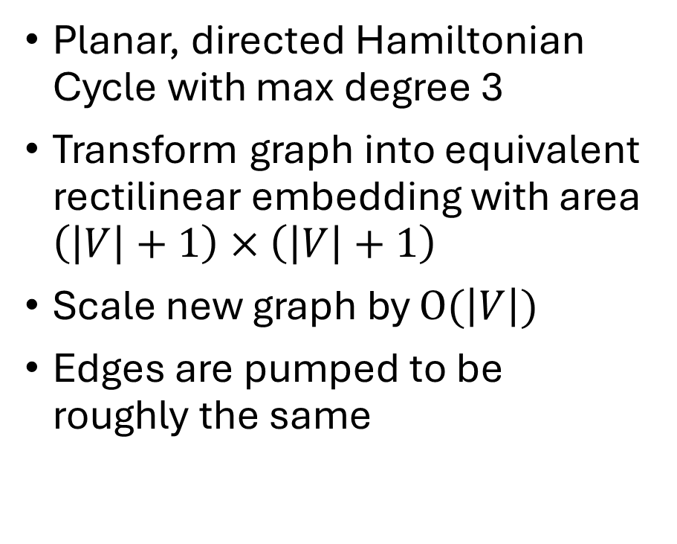
1-Player Celtic!: The “Hard” problems
Planar, directed Hamiltonian Cycle with max degree 3
Transform graph into equivalent rectilinear embedding with area $\left(\left|V\right|+1\right)×\left(\left|V\right|+1\right)$
Scale new graph by $O(\left|V\right|)$
Edges are pumped to be roughly the same

Slide 36
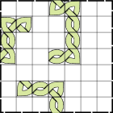
1-Player Celtic!: The “Hard” problems
Center piece represents the “vertex”
Incoming edge(s) are moved to one side
Outgoing edge(s) are moved to the other side
The “choice” is made by the played pieces

Slide 37
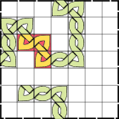
1-Player Celtic!: The “Hard” problems
Center piece represents the “vertex”
Incoming edge(s) are moved to one side
Outgoing edge(s) are moved to the other side
The “choice” is made by the played pieces

Slide 38
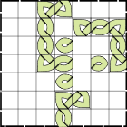
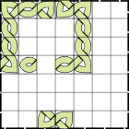
1-Player Celtic!: The “Hard” problems

Slide 39
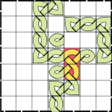
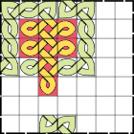
1-Player Celtic!: The “Hard” problems

Slide 40
Generalized 0-Player Celtic!

Slide 41
Generalization: 0-Player
Initial Piece
$$⋮$$
$$n$$
$$[$$
$$]$$
Board Pieces
$$⋯$$
$$n$$
Problem: Does the simulation build a knot of size $≥L$?

Slide 42
0-Player Celtic!
Player Pieces | Board Pieces | Complexity
 |  | P-complete
Problem: Does the simulation build a knot of size $≥L$?

Slide 43
Conclusion
Some piece combinations missing for Generalized 1-Player Celtic!
More balanced pieces for Generalized 2-Player Celtic!
FPT, approximations for maximally sized knots
Is Celtic! a 1st player win, 2nd player win, or a draw?
Pattern based complexity of the knots.
Consider > genus-1 knot assembly.

Slide 44
Tile-based Knot Assembly with Celtic!
Authors: Divya Bajaj, Ryan Knobel, Juan Manuel Perez, Rene Reyes, Ramiro Santos, Tim Wylie

